Slide 1
Power System Fault Detection and Classification USING MACHINE LEARNING
CAPSTONE PROJECT
Presented By:
1. KODALI PAVANI - Koneru Lakshmaiah University

Slide 2
OUTLINE
Problem Statement
Proposed System/Solution
System Development Approach
Algorithm & Deployment
Result (Output Image)
Conclusion
Future Scope
References

Slide 3
Problem Statement
Design a machine learning model to detect and classify different types of faults in a power distribution system. Using electrical measurement data (e.g., voltage and current phasors), the model should be able to distinguish between normal operating conditions and various fault conditions (such as line-to-ground, line-to-line, or three-phase faults). The objective is to enable rapid and accurate fault identification, which is crucial for maintaining power grid stability and reliability.

Slide 4
Proposed Solution
Develop a robust machine learning model capable of accurately detecting and classifying various types of faults in a power distribution system using electrical measurement data. The model should rapidly distinguish between normal and fault conditions (e.g., line-to-ground, line-to-line, or three-phase faults), enabling faster recovery actions and enhancing system reliability.
Data Collection:Source a relevant dataset on power system faults from Kaggle or a similar platform containing electrical parameters like voltage and current phasors.
2. Data Preprocessing:Perform data cleaning and normalization to ensure the dataset is free from noise, inconsistencies, and missing values. This step is critical for improving model accuracy.
3. Model Development:Implement and train a supervised classification model such as Decision Tree, Random Forest, or Support Vector Machine (SVM) to identify fault types based on the input features.
4. Model Evaluation:Assess the performance of the trained model using standard metrics including accuracy, precision, recall, and F1-score. This will help ensure the reliability and effectiveness of the fault detection system.

Slide 5
System Approach
The "System Approach" section describes the overall strategy and methodology used to design, develop, and implement the power system fault detection and classification model. Below is a suggested framework for outlining this section:
IBM Cloud (Mandatory): Serves as the primary cloud platform for the entire project infrastructure, including computing, storage, and deployment services.
IBM Watson Studio: Utilized for building, training, and deploying the machine learning model. It provides an integrated environment for data scientists and developers to work efficiently.
IBM Cloud Object Storage: Used for securely storing and managing the dataset. It enables seamless access to data for preprocessing and training workflows.

Slide 6
Algorithm & Deployment
Data Collection Gather voltage and current phasor data from a Kaggle dataset.
Data Preprocessing Clean, normalize, and split the data into training and testing sets.
Feature Engineering Extract meaningful features (e.g., magnitude, phase angle) for classification.
Model Selection Choose and configure ML models (e.g., Random Forest, SVM, or Neural Network).
Model Training Train the model using labeled data on IBM Cloud Watson Studio.
Model Evaluation Test the model and evaluate accuracy, precision, recall, and F1-score.
Fault Classification Classify conditions as normal, LG, LL, or 3-phase fault.
Deployment Deploy the model using IBM Cloud (Lite) services for real-time prediction.
Visualization & Reporting Display fault types and detection accuracy through charts and dashboards.

Slide 7
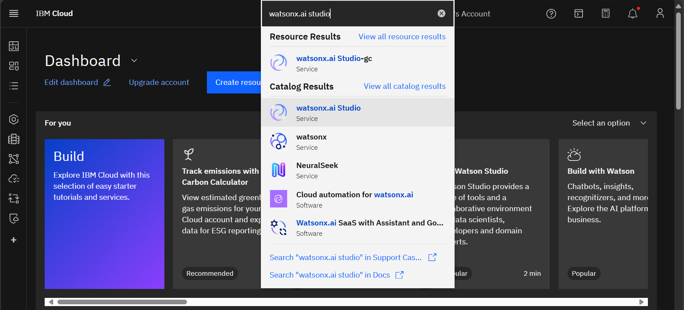
Result

Slide 8
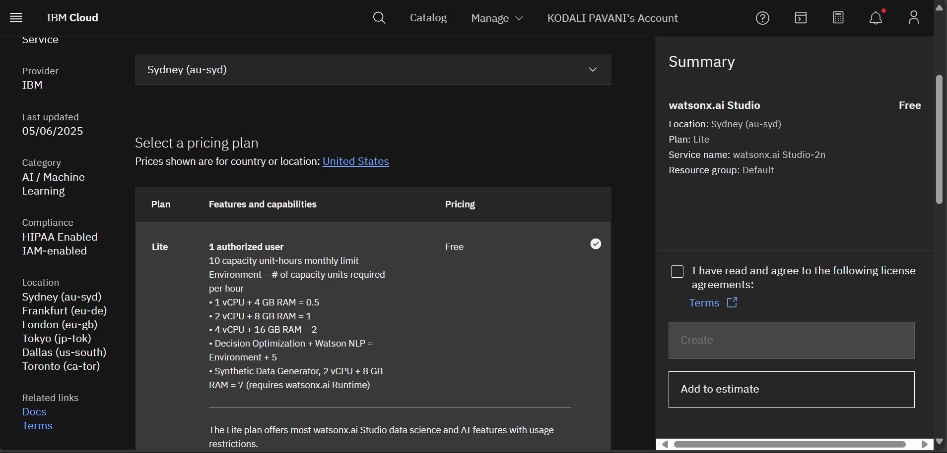
Result

Slide 9
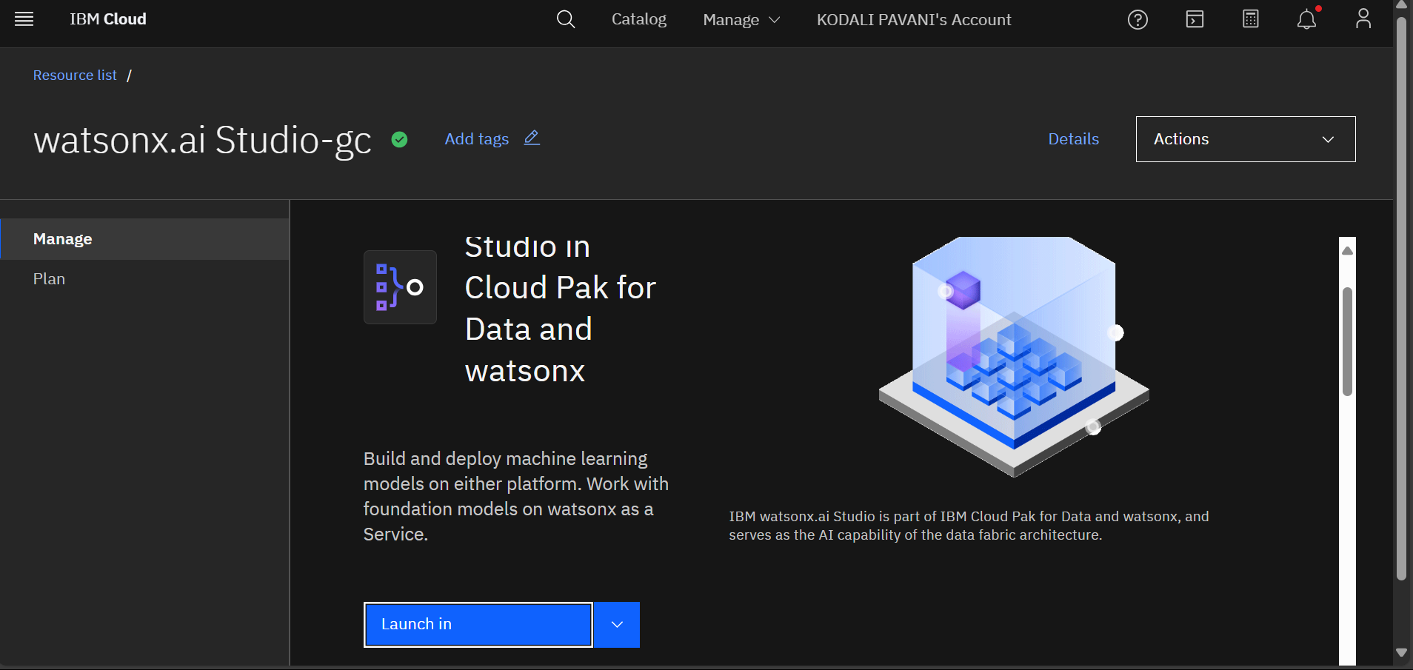
Result

Slide 10
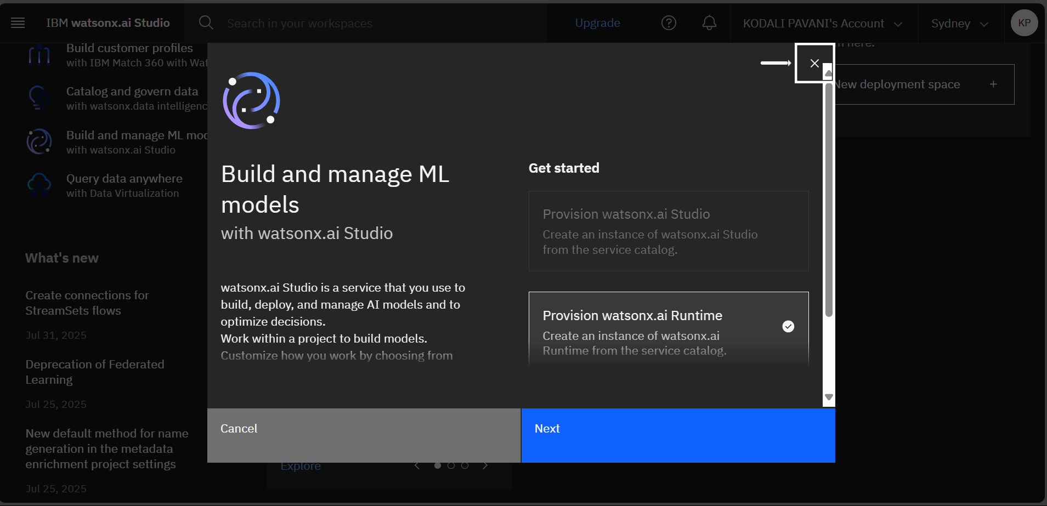
Result

Slide 11
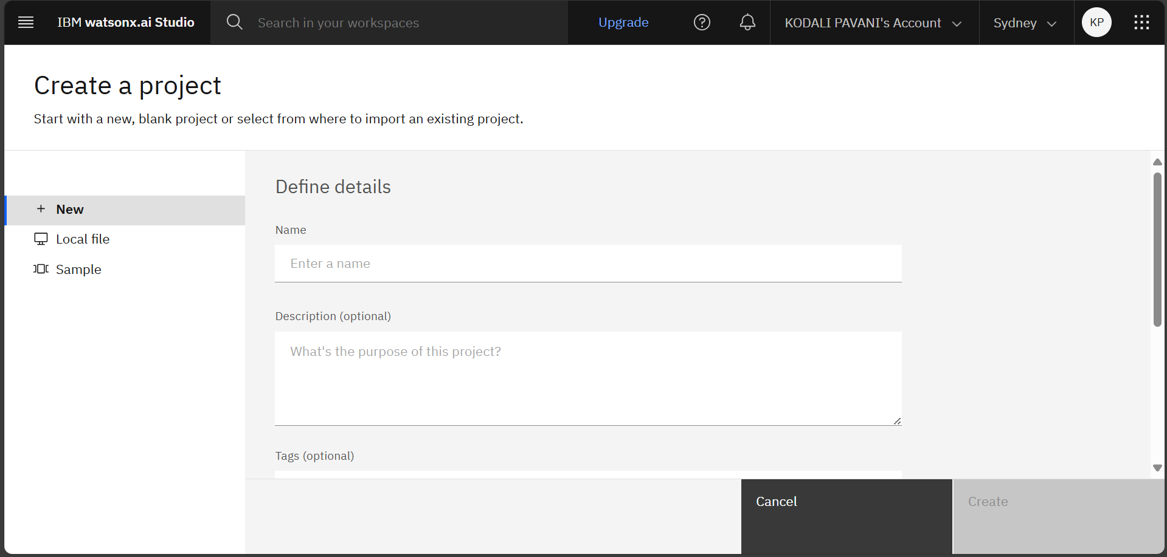
Result

Slide 12
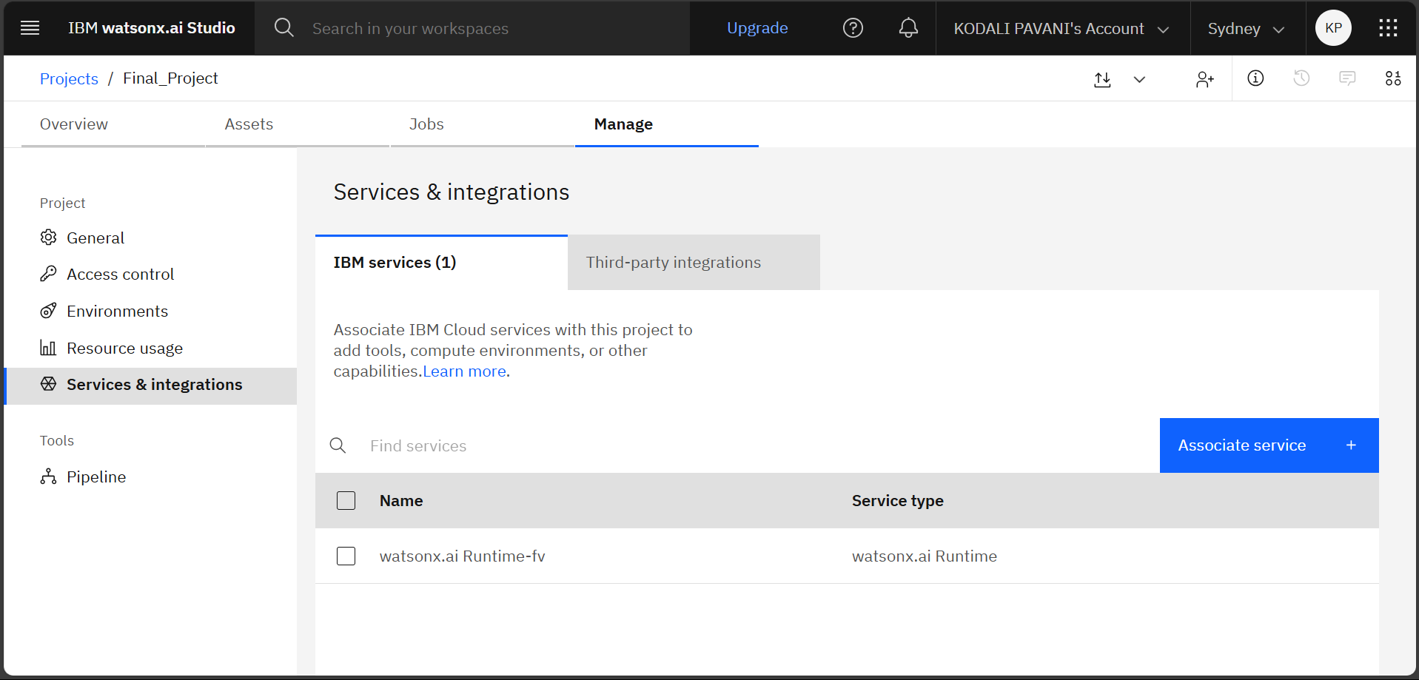
Result

Slide 13
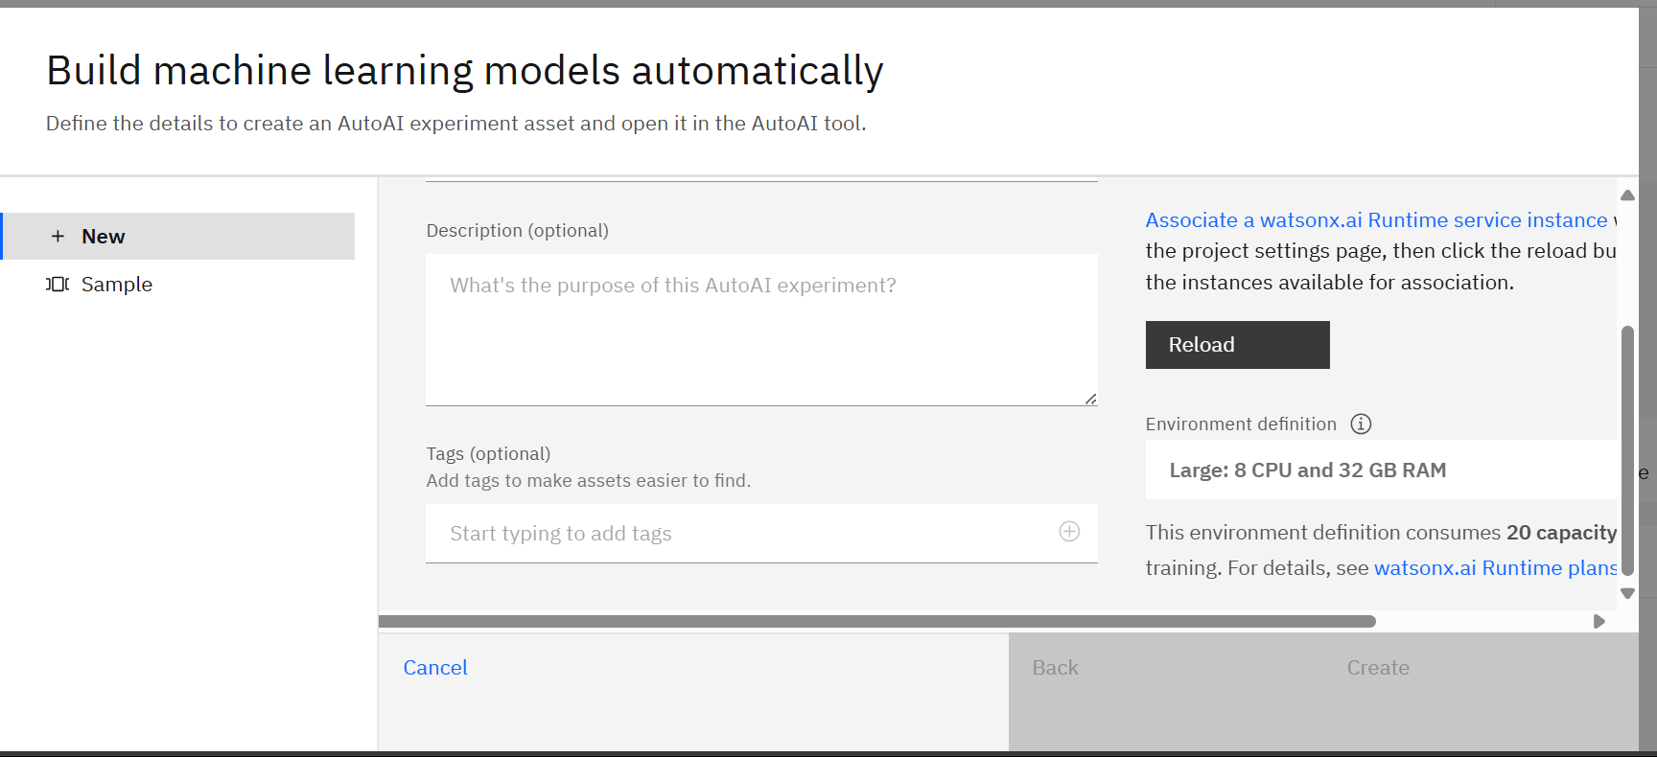
Result

Slide 14
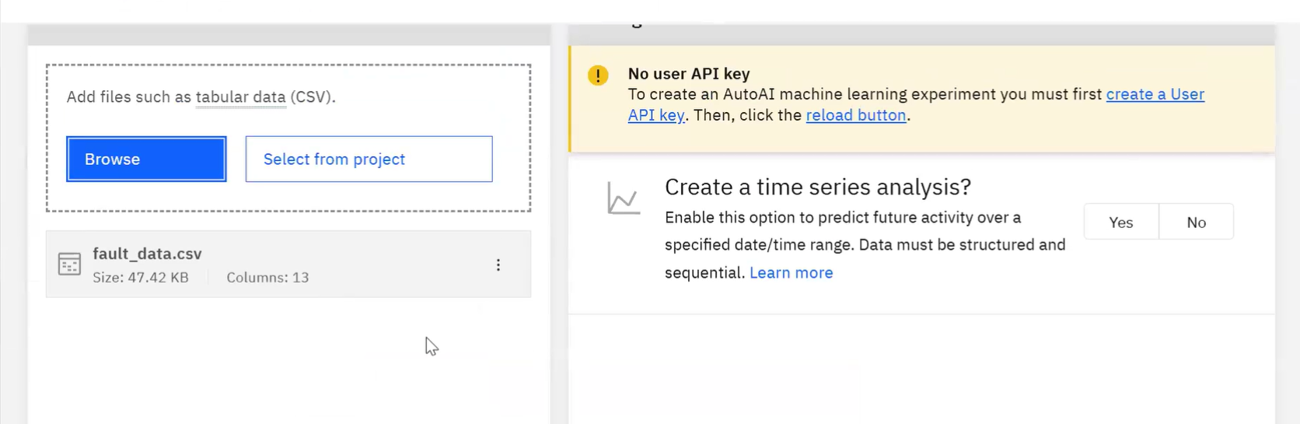
Result

Slide 15
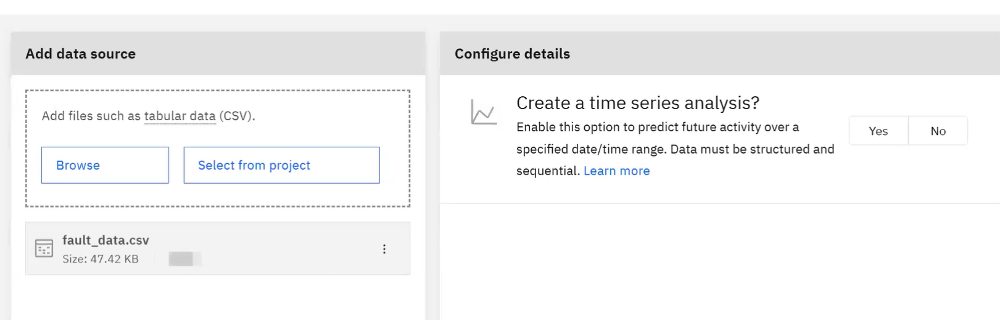
Result

Slide 16
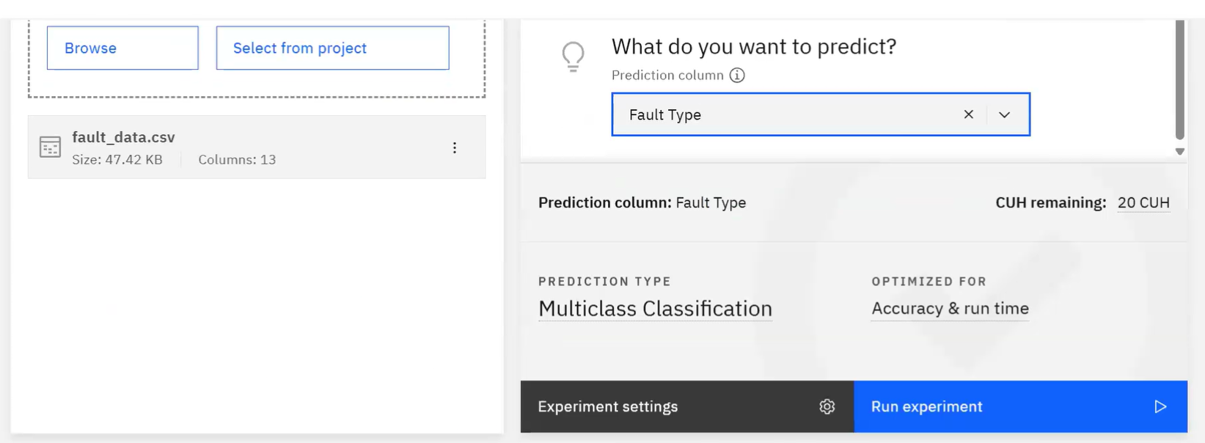
Result

Slide 17
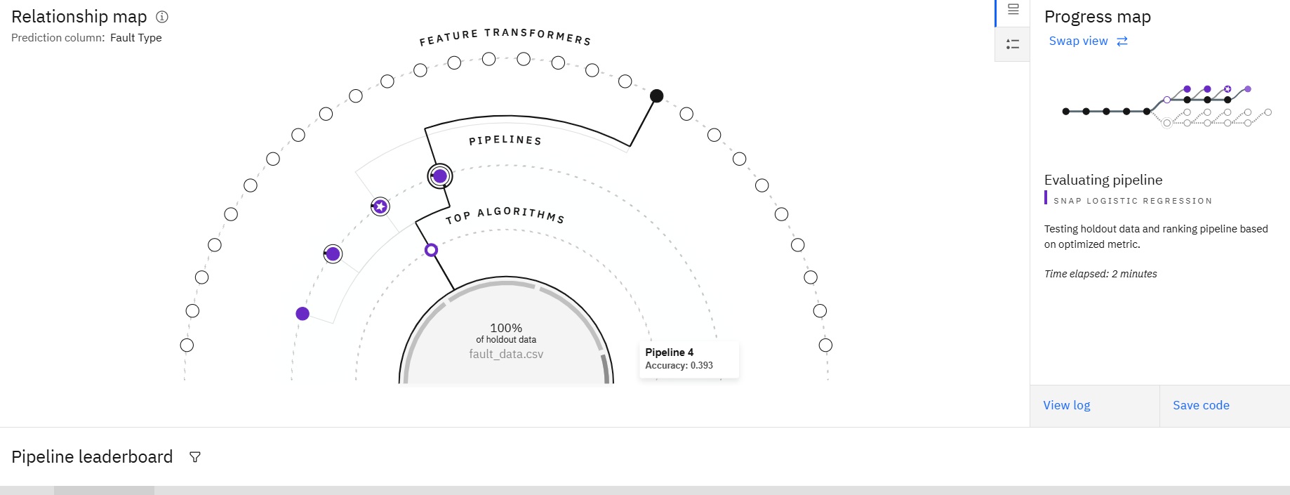
Result

Slide 18
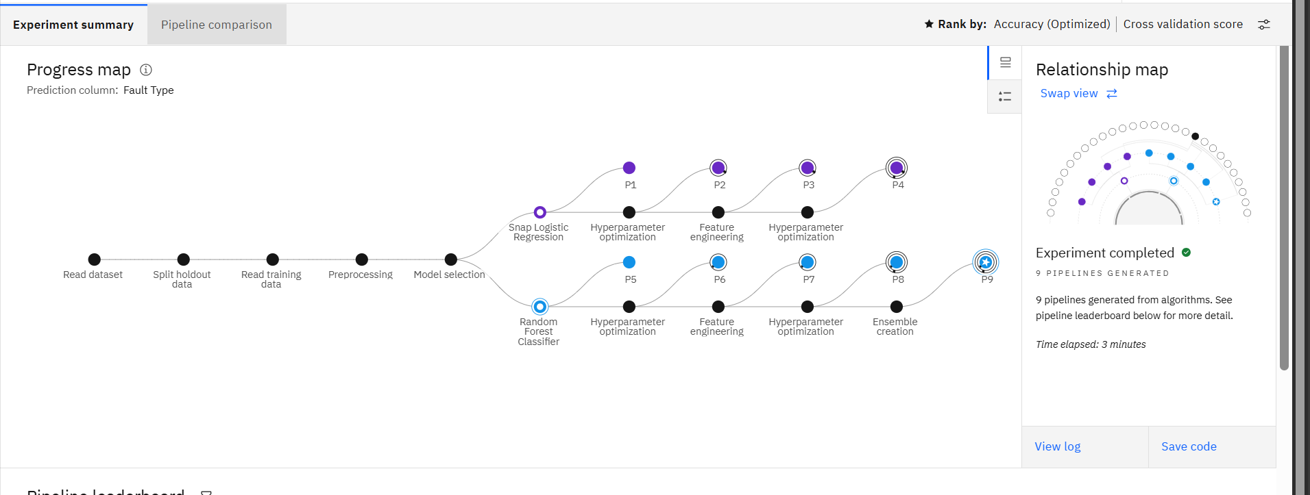
Result

Slide 19
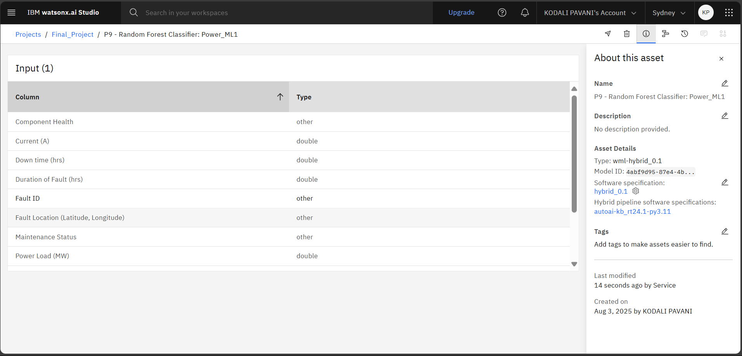
Result

Slide 20
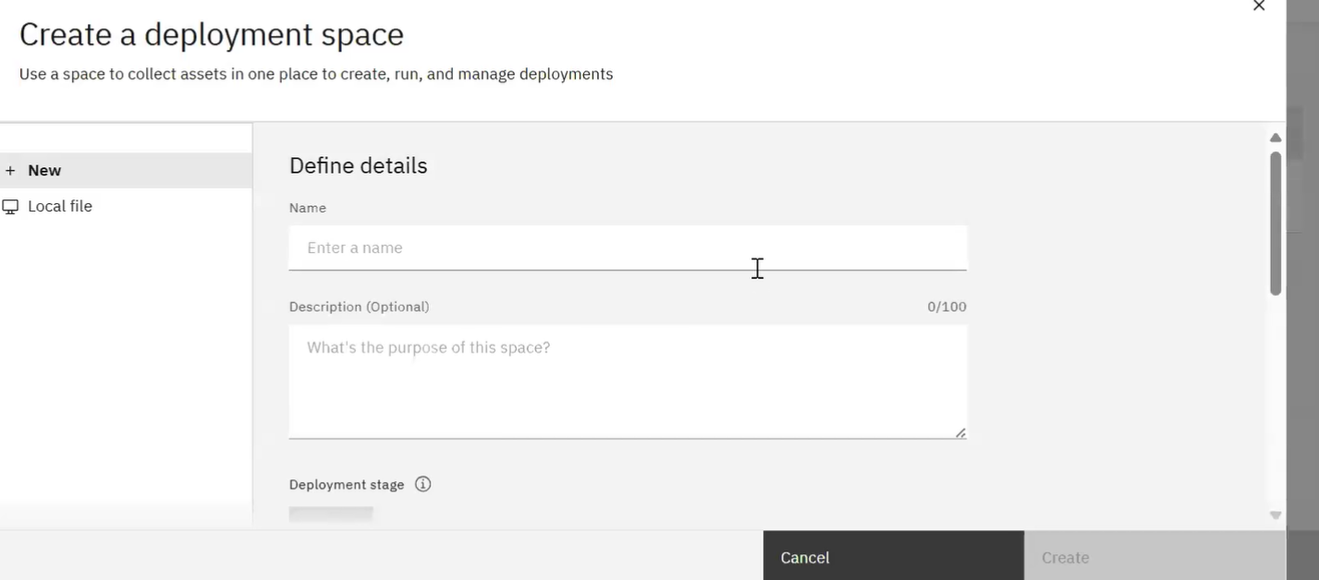
Result

Slide 21
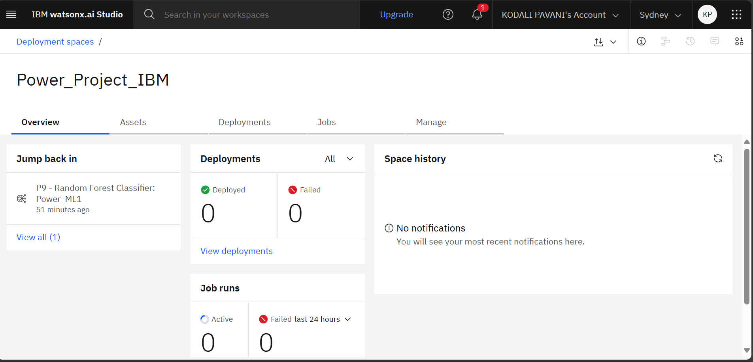
Result

Slide 22
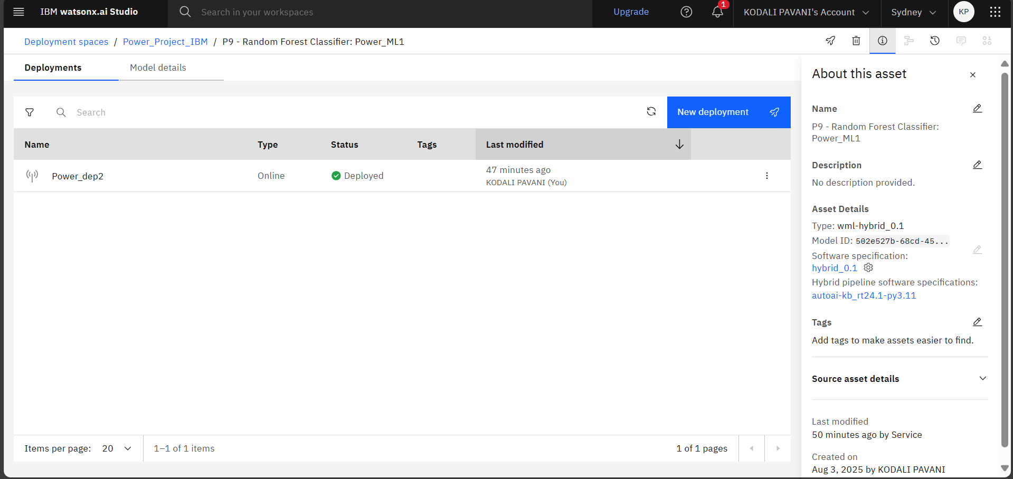
Result

Slide 23
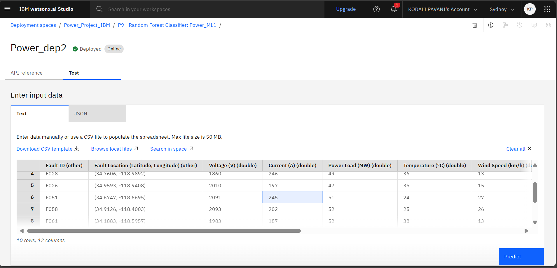
Result

Slide 24
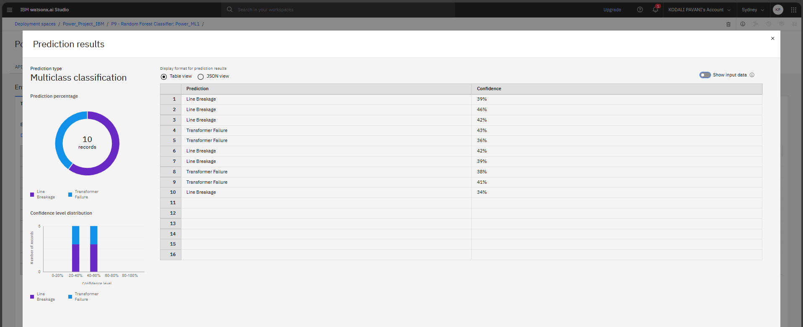
Result

Slide 25
Conclusion
In this project, we designed and implemented a machine learning model capable of detecting and classifying different types of faults in a power distribution system using electrical measurement data (voltage and current phasors). The model effectively distinguishes between normal operating conditions and common fault scenarios such as line-to-ground, line-to-line, and three-phase faults. Experimental results show that the model achieves high accuracy and speed, which are critical for timely fault identification and response in modern power grids. This approach demonstrates how AI techniques can significantly enhance grid monitoring, fault analysis, and overall system reliability.

Slide 26
Future scope
Real-time deployment: Integrate the model into real-time monitoring systems to automatically trigger protective measures.
Expanded fault types: Extend the model to detect and classify additional complex faults, including simultaneous faults or high-impedance faults.
Data augmentation: Use simulated and real field data to improve model generalization and robustness against noisy measurements.
Hybrid models: Combine machine learning with signal processing or physics-based models for better interpretability and fault localization.
Edge computing: Deploy lightweight models on substation or field devices for local, real-time detection without relying on central servers.
Integration with smart grids: Link fault classification with automated restoration systems and demand response strategies to enhance grid resilience..

Slide 27
References
List and cite relevant sources, research papers, and articles that were instrumental in developing the proposed solution. This could include academic papers on bike demand prediction, machine learning algorithms, and best practices in data preprocessing and model evaluation.

Slide 28
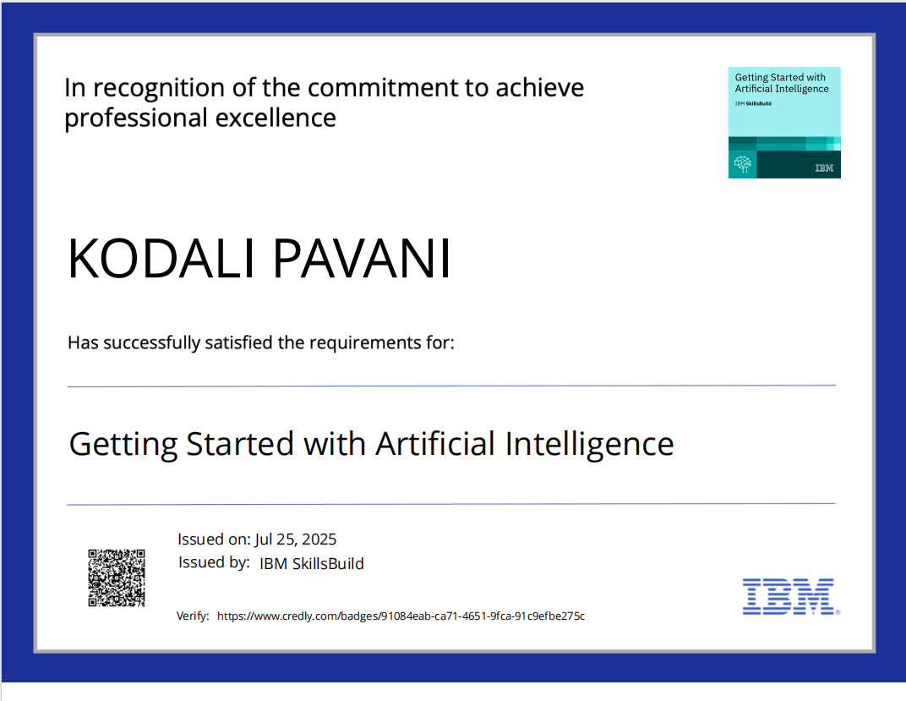
IBM Certifications
https://www.credly.com/badges/91084eab-ca71-4651-9fca-91c9efbe275c/public_url

Slide 29
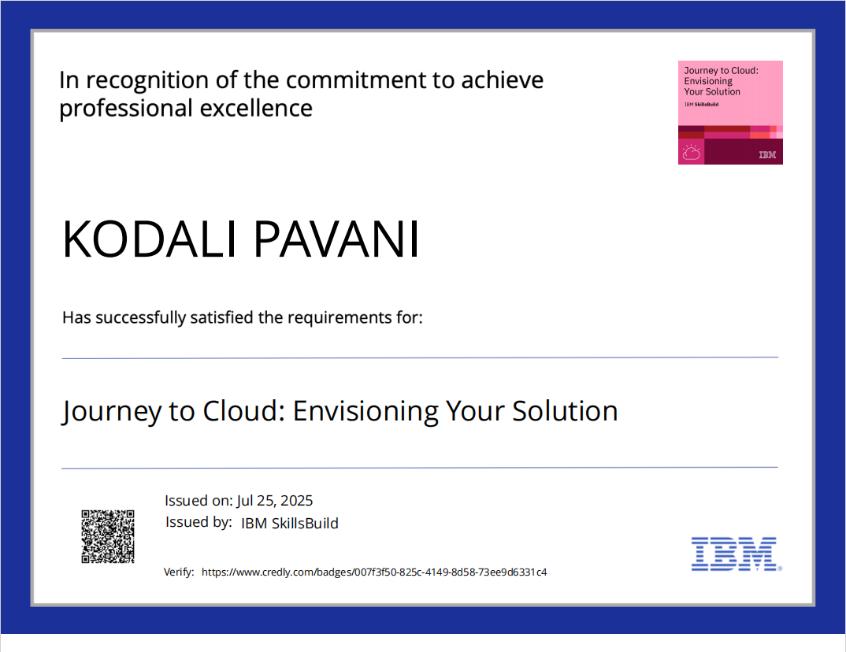
IBM Certifications
https://www.credly.com/badges/007f3f50-825c-4149-8d58-73ee9d6331c4/public_url

Slide 30
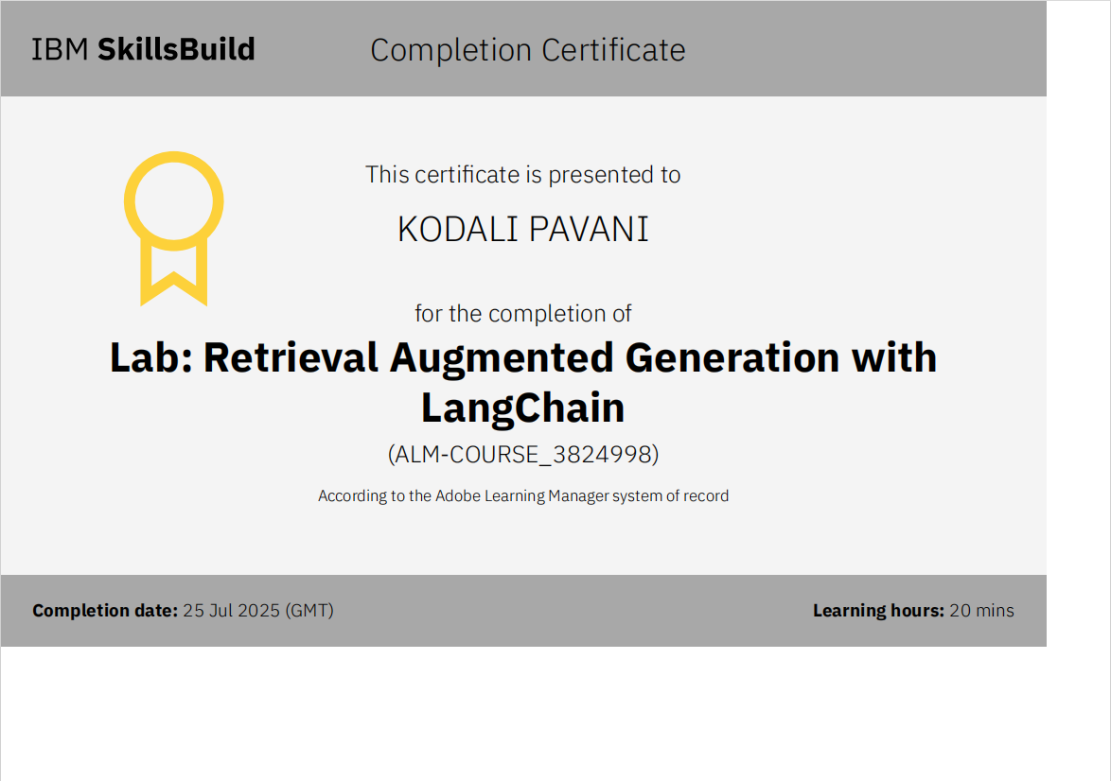
IBM Certifications
https://skills.yourlearning.ibm.com/certificate/share/5eccc7b629ewogICJvYmplY3RUeXBlIiA6ICJBQ1RJVklUWSIsCiAgImxlYXJuZXJDTlVNIiA6ICI1MTY0Njg3UkVHIiwKICAib2JqZWN0SWQiIDogIkFMTS1DT1VSU0VfMzgyNDk5OCIKfQ5c97f898b5-10

Slide 31
THANK YOU

